Slide 1
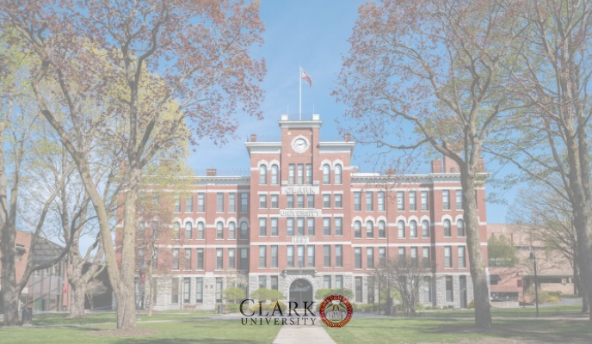
Campus Compass
Vinod Nithin Kumar Rachakonda
Subhash Medipalli
Sai Nithisha Marripelly

Slide 2
Problem Statement
Navigating Clark University and finding parking is a major challenge, especially for new students. Locating the nearest parking spot to a specific building and knowing space availability is often difficult.
Our AI-based object detection model solves this by identifying available spots and calculating the shortest distance to campus buildings.

Slide 3
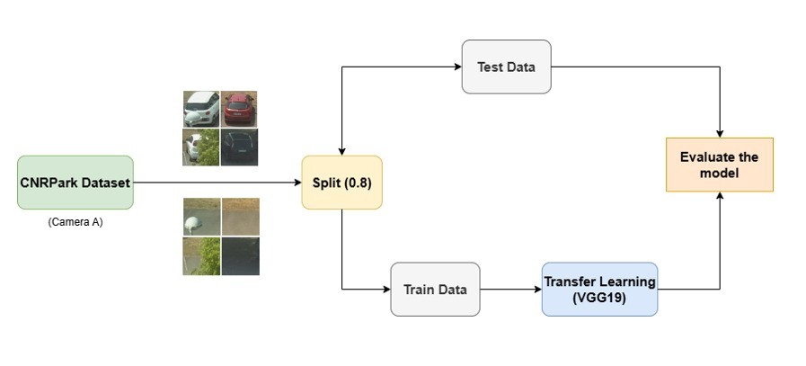
Model Architecture

Slide 4
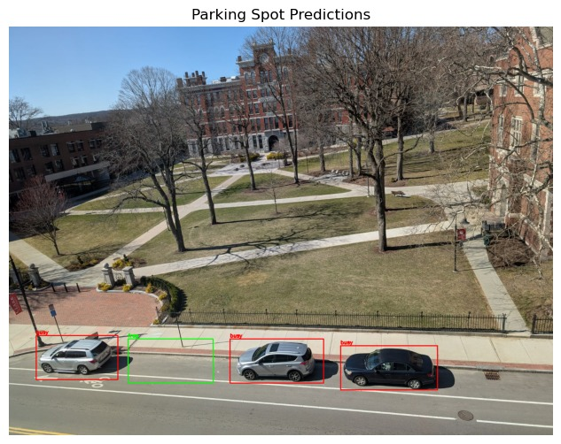
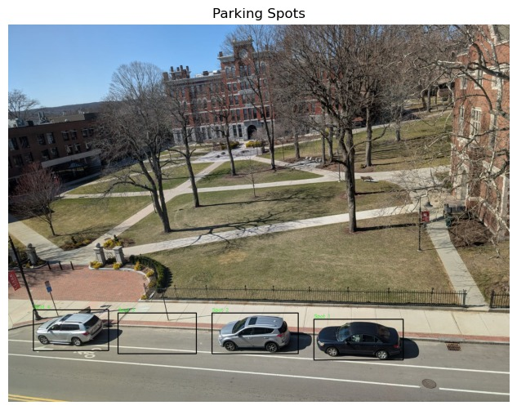
Define Parking spaces
Identifying vacant spots

Slide 5
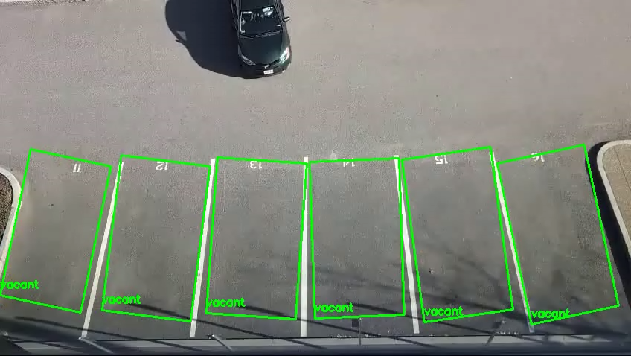

Slide 6
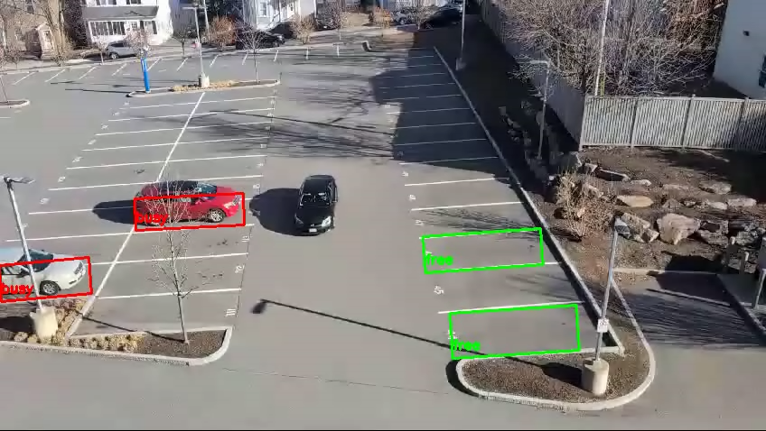

Slide 7
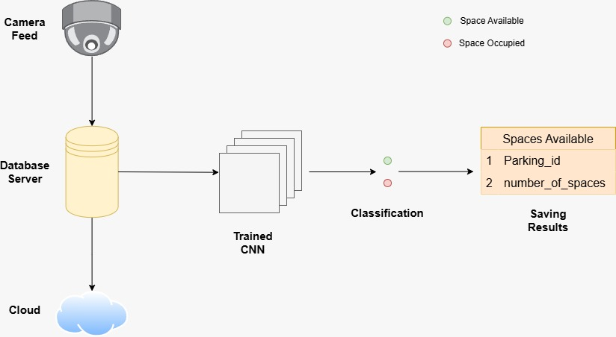
Implementation Architecture

Slide 8
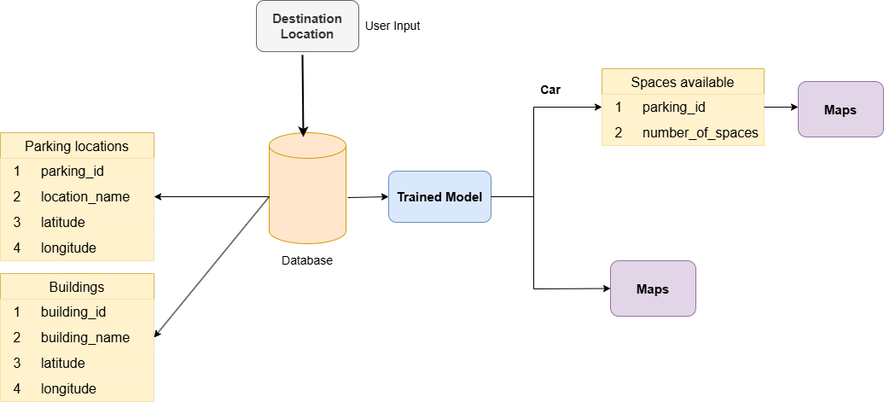
Application Architecture

Slide 9
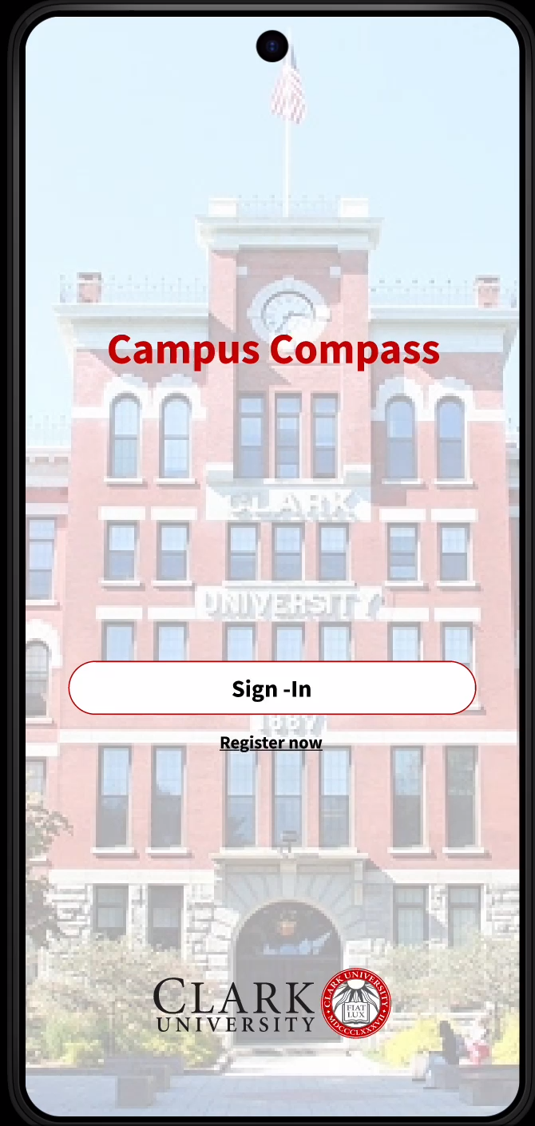

Slide 10
Key advantages
No expensive hardware required
Built by students, For students
Seamless campus navigation
Live parking spaces availability

